Slide 1
CODEFLIX
Q1 Churn Rates
Gabriel Molina
March 14, 2022

Slide 2
We will cover:
Research Questions
Query Structure
Analysis

Slide 3
1. Research Questions

Slide 4
1.1 What Do We Want to Know?
Four months into the life of the company, we want to analyze our progress!
Specifically, we want to compare two segments of users, each acquired through a different channel: segments 87 and 30.
We will do this by calculating the respective churn rates for each month of Q1.
Churn Rate = Cancellations / Total Users
From Investopedia, churn is a useful metric because it “provides clarity on how well the business is retaining customers, which is a reflection on the quality of the service the business is providing, as well as its usefulness.”

Slide 5
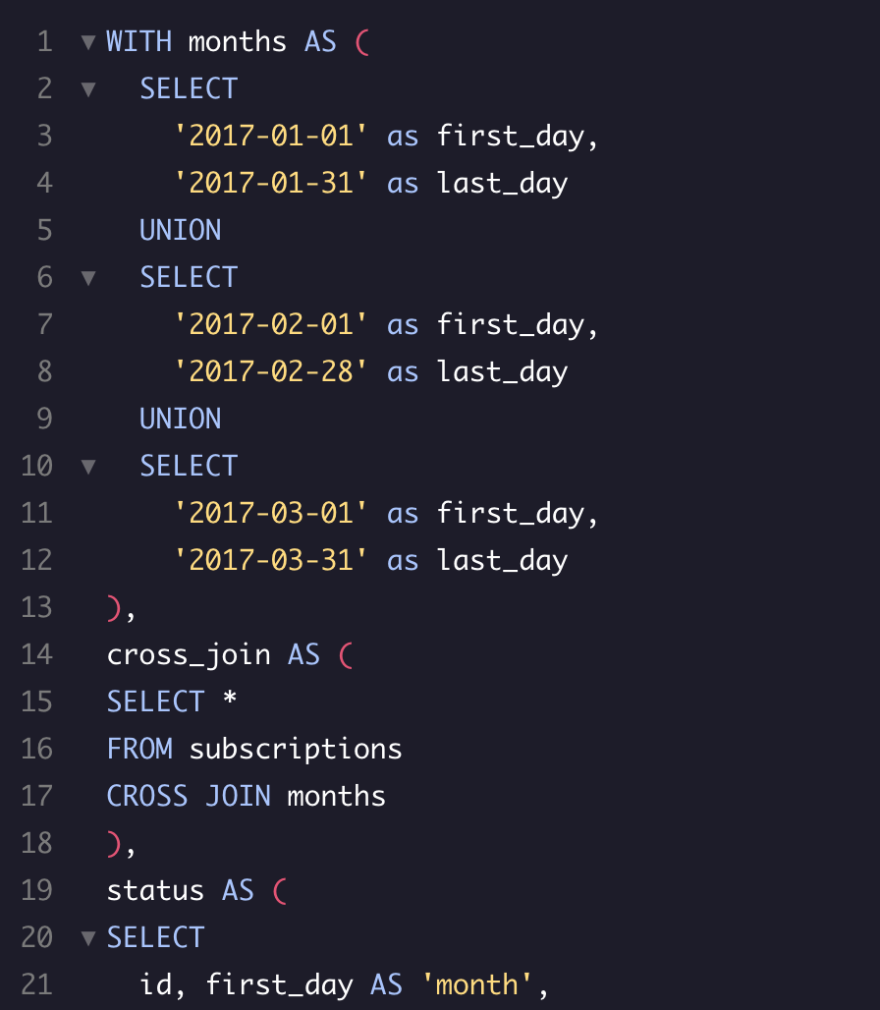
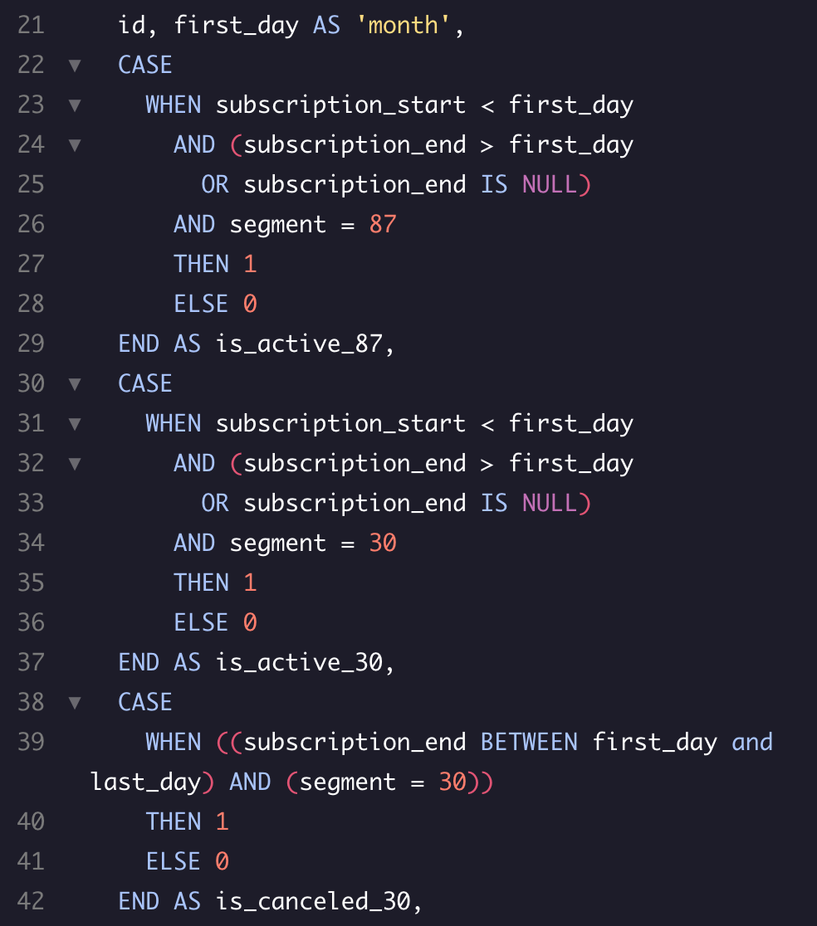
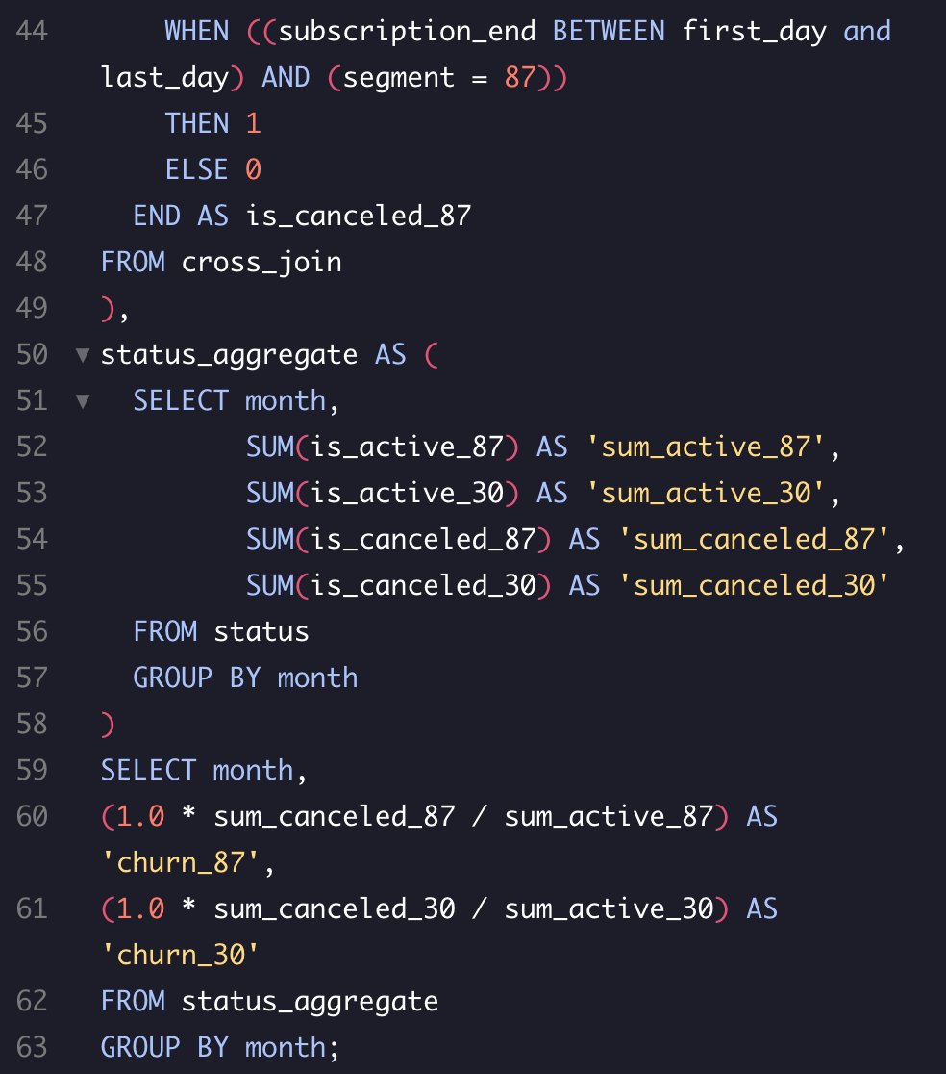
2. Query Structure

Slide 6
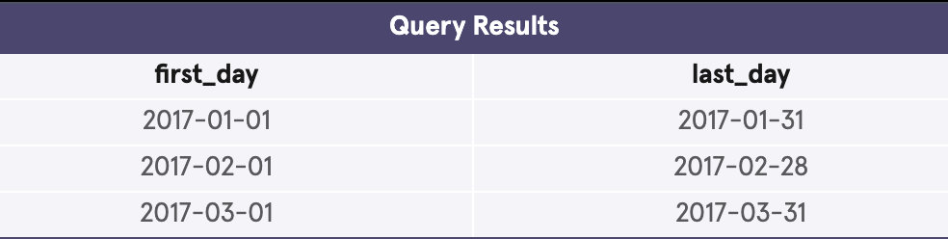
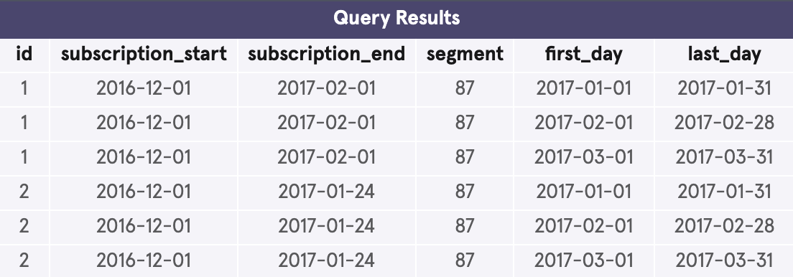
2.1 Overall Structure, months, and cross_join
The majority of our query uses a WITH statement to create temporary tables. They build off of one another until we can select for our final churn calculation.
Our first temporary table, months, contains the first and last day of each month in Q1, 2017.
Our second temporary table, cross_join, combines months with subscriptions.
WITH months AS (
SELECT
'2017-01-01' as first_day,
'2017-01-31' as last_day
UNION
SELECT
'2017-02-01' as first_day,
'2017-02-28' as last_day
UNION
SELECT
'2017-03-01' as first_day,
'2017-03-31' as last_day
),
cross_join AS (
SELECT *
FROM subscriptions
CROSS JOIN months
),
...

Slide 7
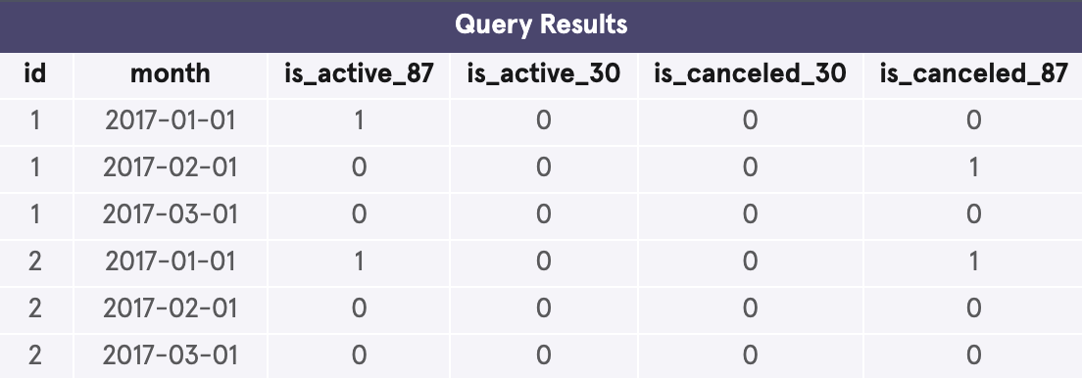
2.2 status
...
status AS (
SELECT
id, first_day AS 'month',
CASE
WHEN subscription_start < first_day
AND (subscription_end > first_day
OR subscription_end IS NULL)
AND segment = 87
THEN 1
ELSE 0
END AS is_active_87,
CASE
WHEN subscription_start < first_day
AND (subscription_end > first_day
OR subscription_end IS NULL)
AND segment = 30
THEN 1
ELSE 0
END AS is_active_30,
CASE
WHEN ((subscription_end BETWEEN first_day and last_day) AND (segment = 30))
THEN 1
ELSE 0
END AS is_canceled_30,
CASE
WHEN ((subscription_end BETWEEN first_day and last_day) AND (segment = 87))
THEN 1
ELSE 0
END AS is_canceled_87
FROM cross_join
),
...
Our third temporary table, status, simplifies our previous table cross_join to show only whether a user was active at the start of a month, and whether they canceled within that month. These are also separated by whether the user is part of segment 87 or 30.
1 means “True,” 0 means “False.”

Slide 8
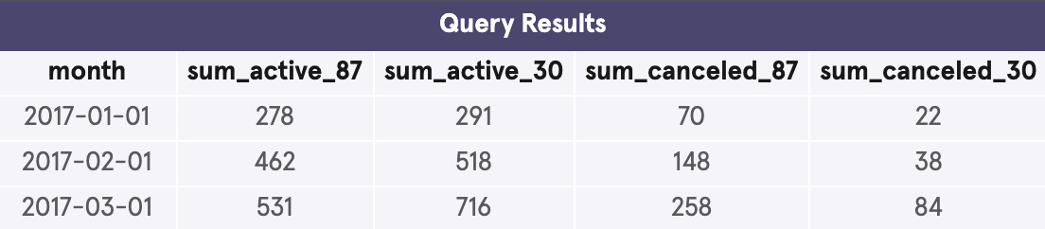
2.3 status aggregate
Our fourth and final temporary table, status aggregate, simply sums the active and cancelled columns from status, grouped by month.
...
status_aggregate AS (
SELECT month,
SUM(is_active_87) AS 'sum_active_87',
SUM(is_active_30) AS 'sum_active_30',
SUM(is_canceled_87) AS 'sum_canceled_87',
SUM(is_canceled_30) AS 'sum_canceled_30'
FROM status
GROUP BY month
)
...

Slide 9
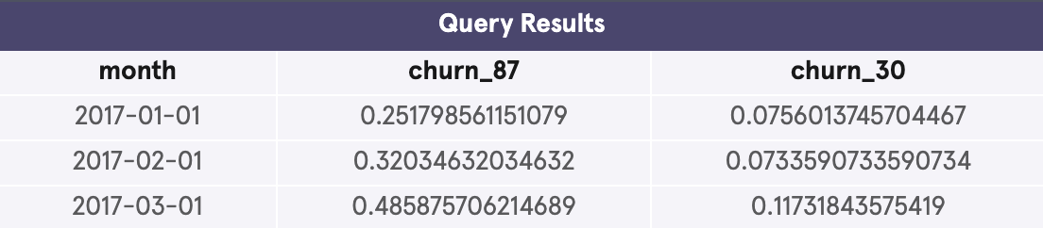
2.4 Results
With our final temporary table completed, we can select for the calculation of our churn rates by dividing sum_active by sum_canceled for each segment group.
See the results below:
...
SELECT month,
(1.0 * sum_canceled_87 / sum_active_87) AS 'churn_87',
(1.0 * sum_canceled_30 / sum_active_30) AS 'churn_30'
FROM status_aggregate
GROUP BY month;

Slide 10
3. Analysis

Slide 11
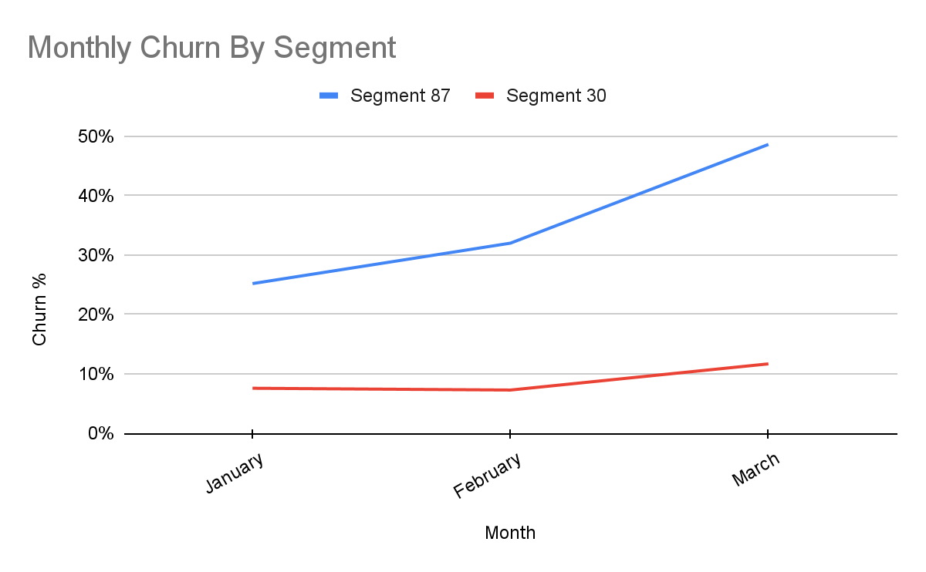
3.1 Observations
Month | Churn - 87 | Churn - 30
January | 25.2% | 7.6%
February | 32.0% | 7.3%
March | 48.6% | 11.7%
With our final results, we can make some immediate observations:
The churn for segment 30 is significantly lower than that for segment 87.
There is a general trend of increasing churn, particularly in segment 87.

Slide 12
3.2 Takeaways
Month | Churn - 87 | Churn - 30
January | 25.2% | 7.6%
February | 32.0% | 7.3%
March | 48.6% | 11.7%
We have to qualify our analysis with the fact that we only have data for three months. A longer time period will allow us to make more accurate predictions.
With that in mind, we must note:
Segment 87’s churn is both higher and increasing faster than segment 30. We need to find out why these customers in particular are leaving.
We could implement an exit survey for leaving customers to let us know why.

Slide 13

“Make your product easier to buy than your competition, or you will find your customers buying from them, not you.”
– Mark Cuban

